Slide 1
CS 4900 Project Week 4
Group: 6
Michael Hayes
Ryan Slaybaugh
Semira Pinder

Slide 2
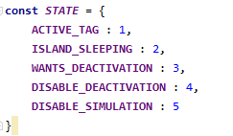

Fixing Character Movement
Character Movement was being set to a deactivated state
Set the activation state to disable deactivation.

Slide 3

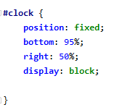

Creating a stopwatch overlay
Created HTML Div for timer position
Added css for clock to be at a fixed position
In pointerLockControls added start clock to handler.

Slide 4
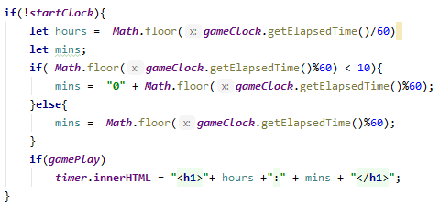
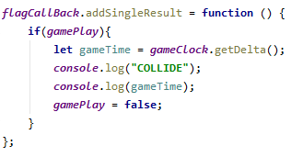
Flag Trigger Event
Added a callback for flag collision.
If player touches the flag clock timer stops.
Using MOD and division to change clock time(in seconds) into minutes/seconds.

Slide 5
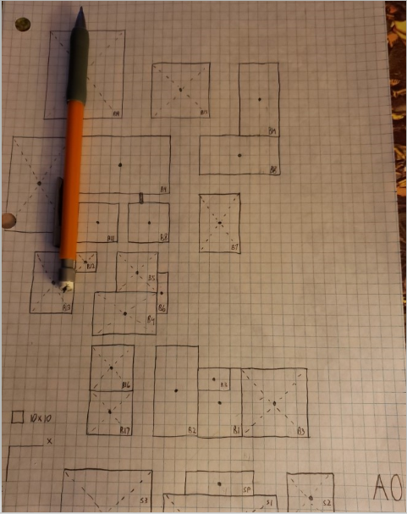
Level Graphing
Use of graph paper
Ease of object placement
Watch out for in-game distance

Slide 6
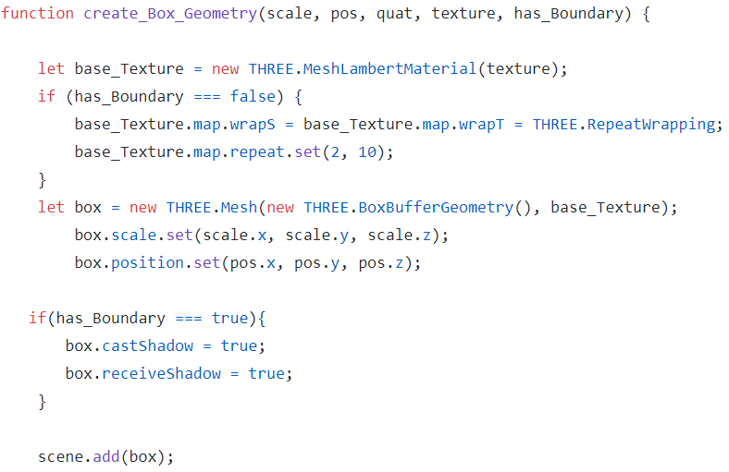
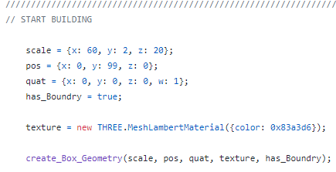
Object Creation Helper
Helper for primitive object creation
Separation of interactables

Slide 7
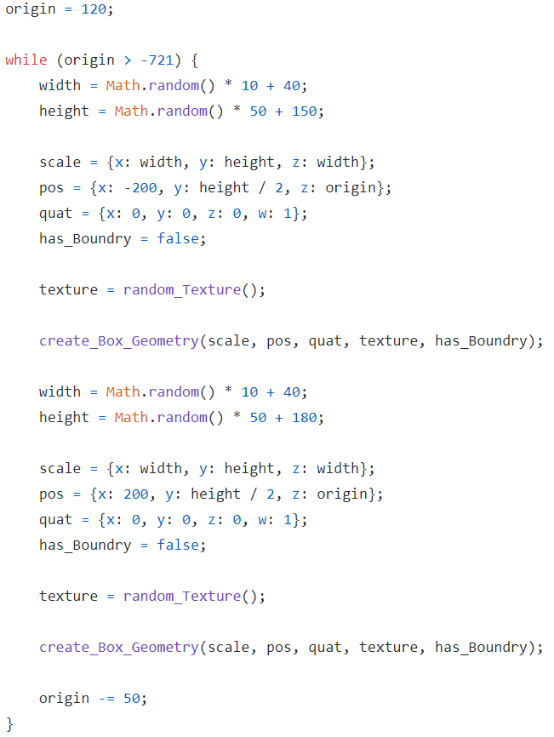
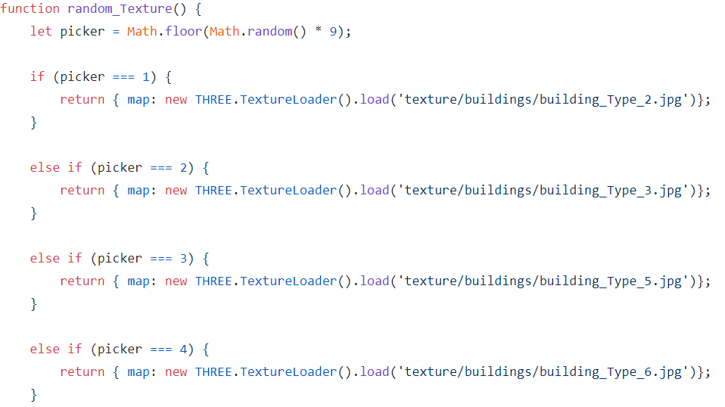
Level Boundary
While loop to randomly generate boundary
Math.random to generate variable sizes
Applying random texture.

Slide 8
Death Animation and Blender
Unhiding keyframes in the dope sheet
Editing the animation made easy

Slide 9


Importing Animations
Problems caused by computer, and by AnimationAction

Slide 10
Plans for next week
Finalize game movement (disable movement/jump in air)
Fine tune animations, import better and make more assets
Work on transition from level to menu after completion

